Slide 1
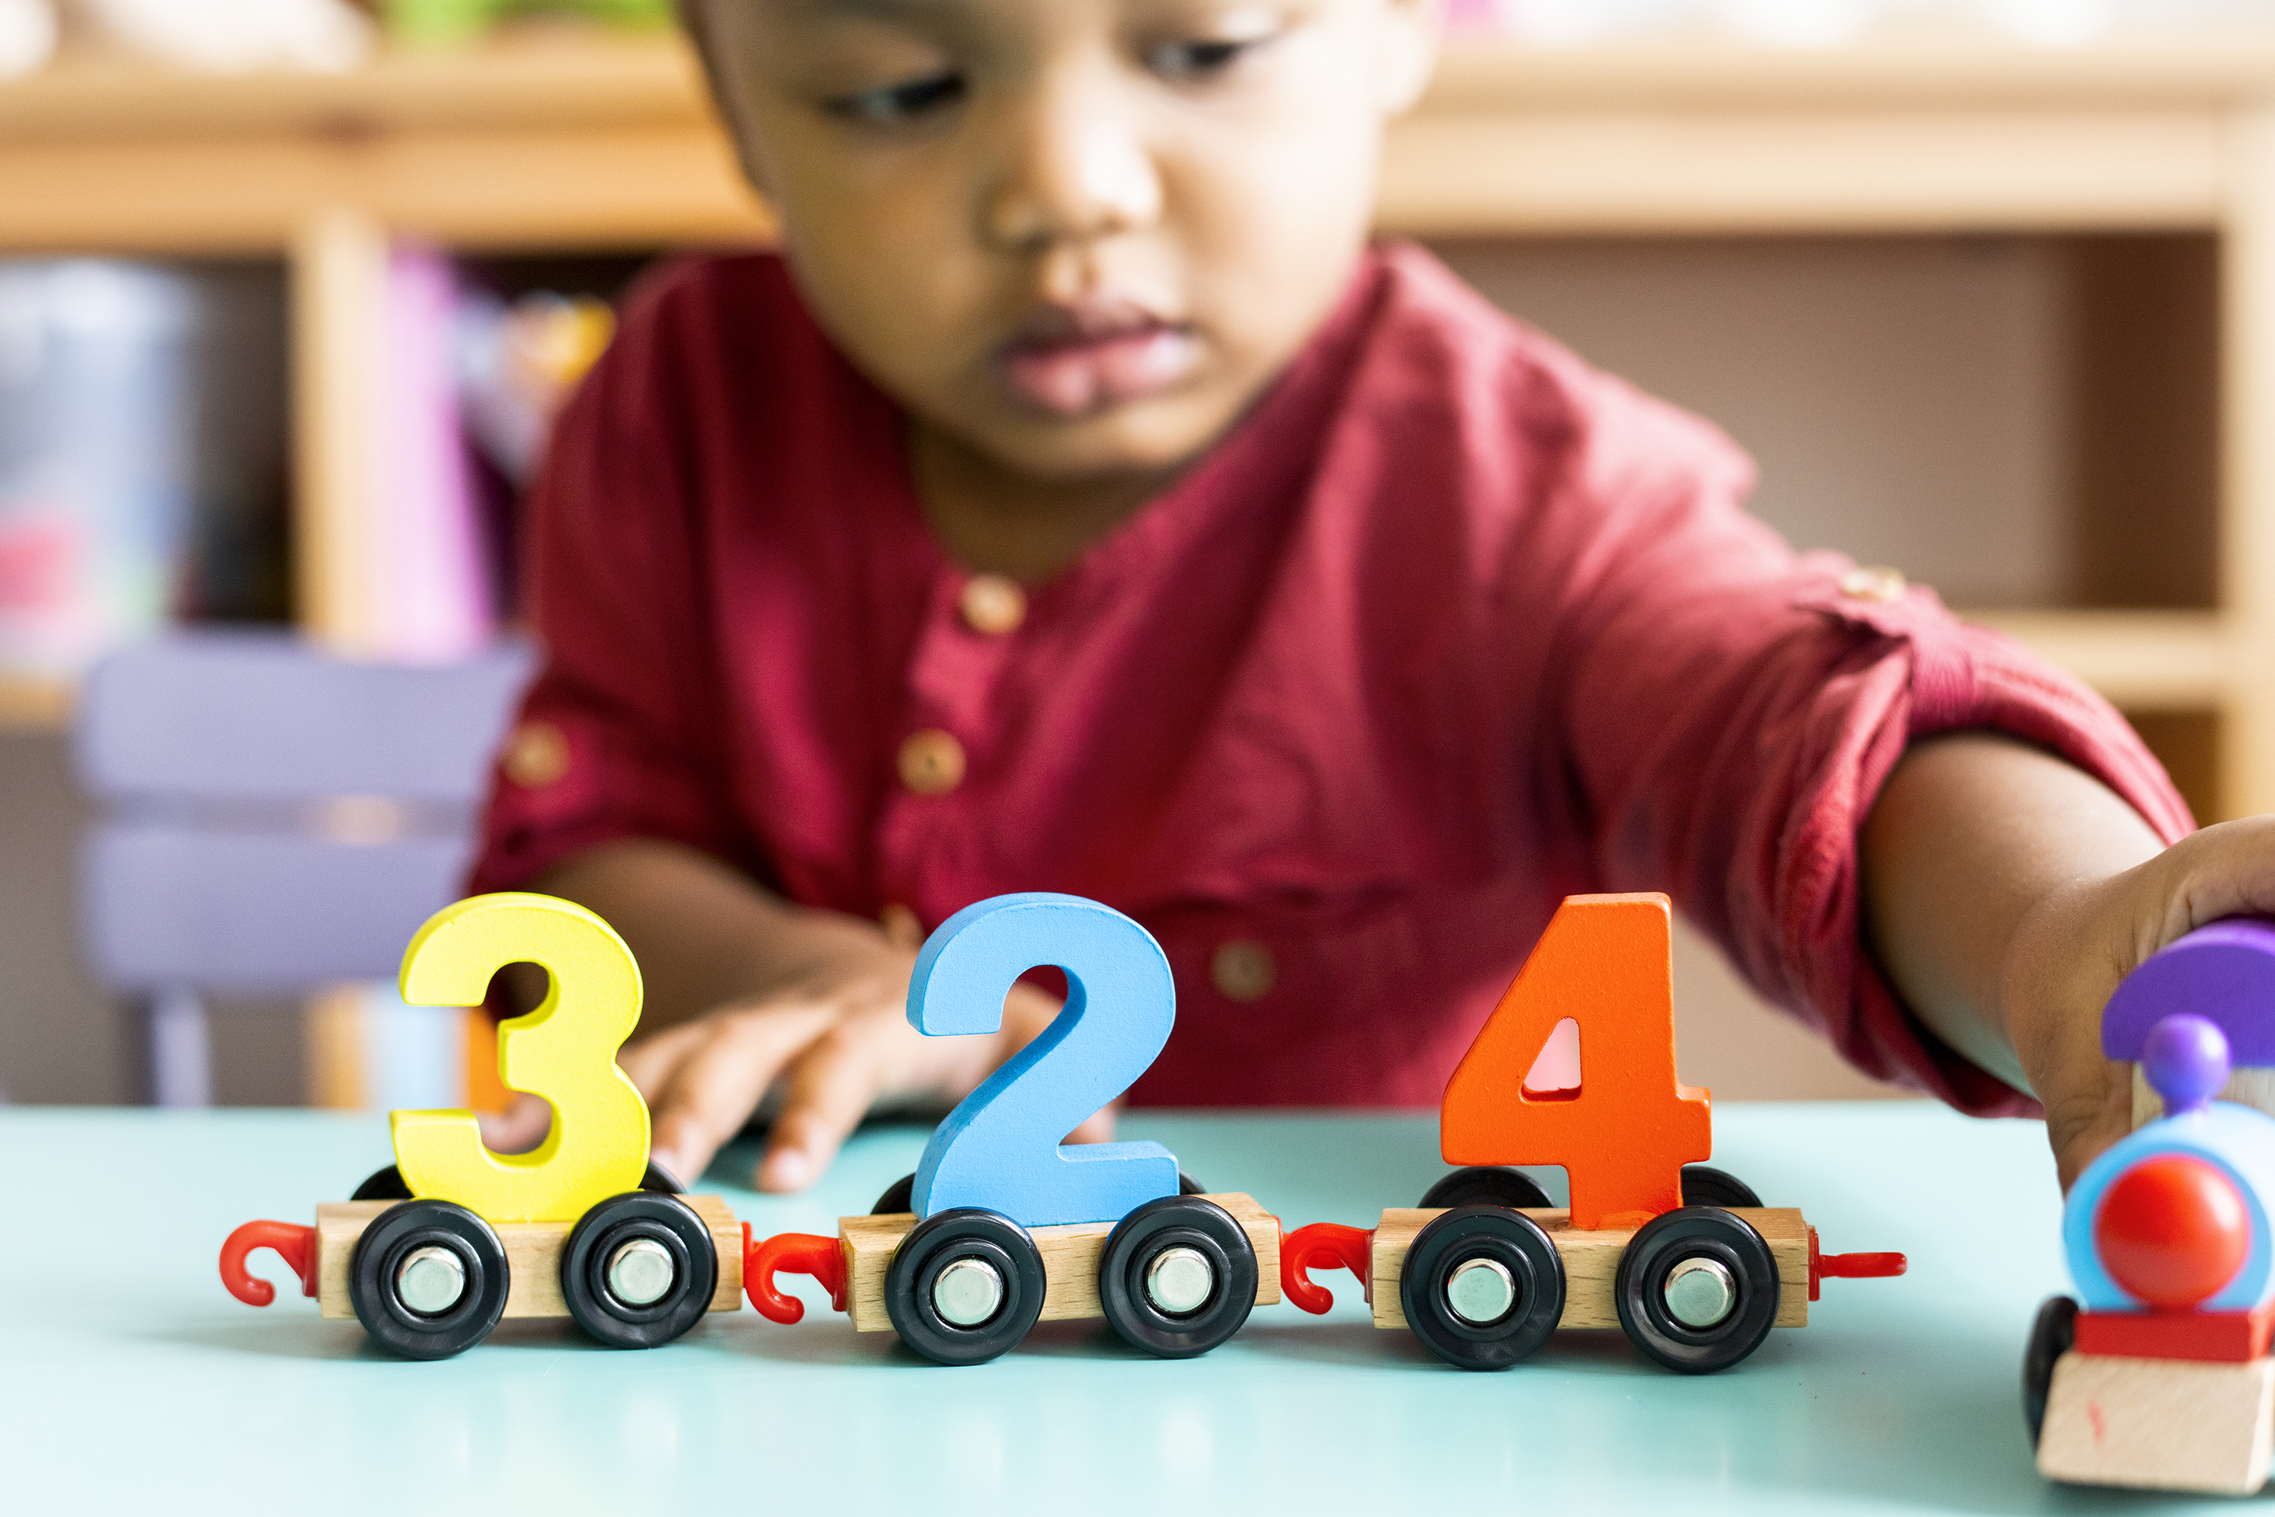
CSE 280 Discrete Mathematics

Slide 2
Syllabus / Course Layout
Schedule (reading, homework)
Reading / Activities – ZyBooks
Homework – Google Colab, grading, how to submit
Groups – 2-4, 3 is ideal
Grading
Resubmission policy
Questions?

Slide 3
What is Discrete Mathematics?
"the branch of mathematics dealing with objects that can assume only distinct, separated values" – Wolfram Mathworld
In contrast with continuous mathematics, which deals with things that vary smoothly / continuous numbers (e.g., calculus)
https://mathworld.wolfram.com/DiscreteMathematics.html

Slide 4
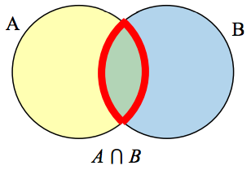
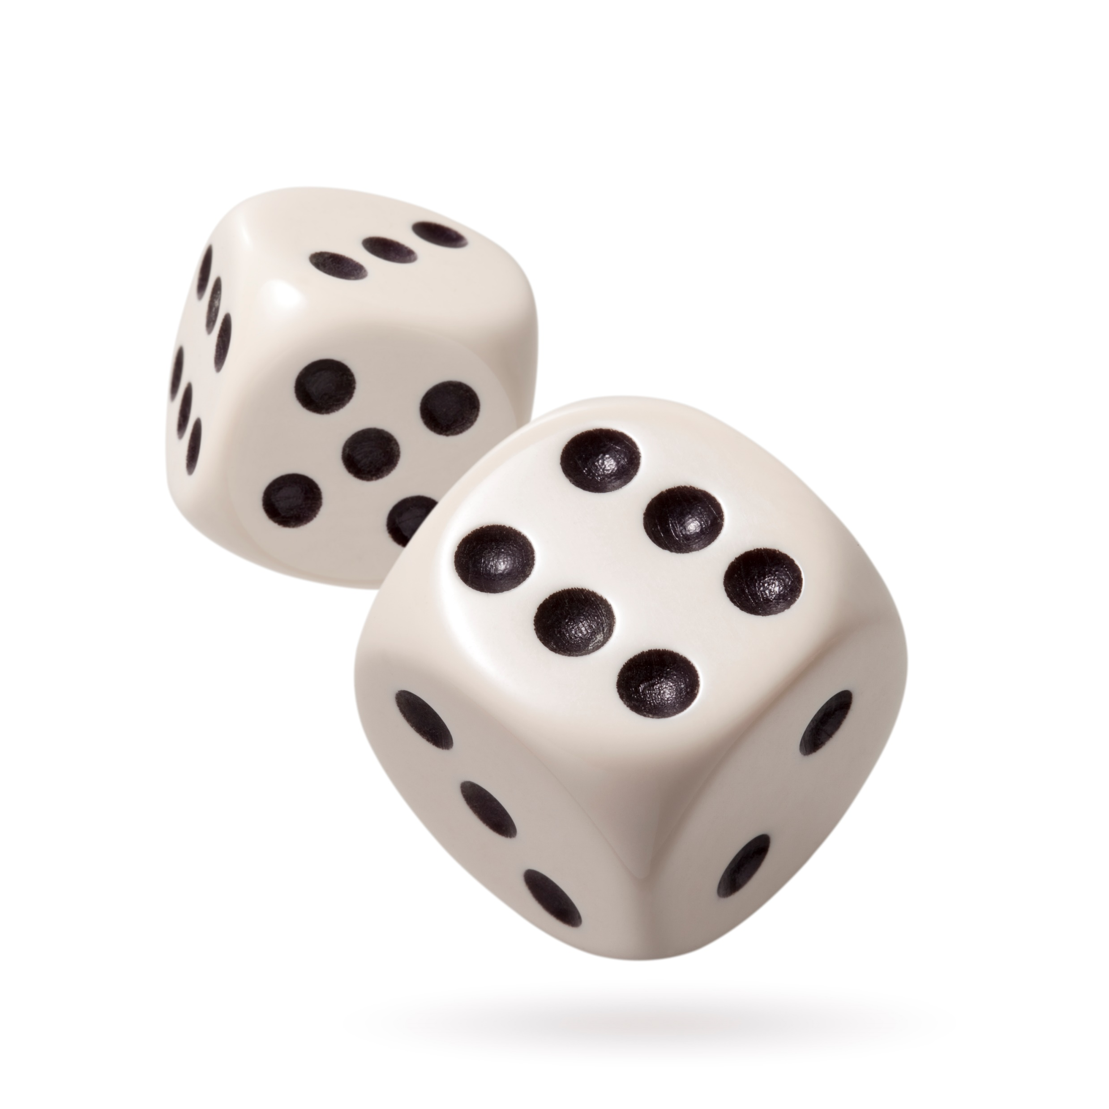
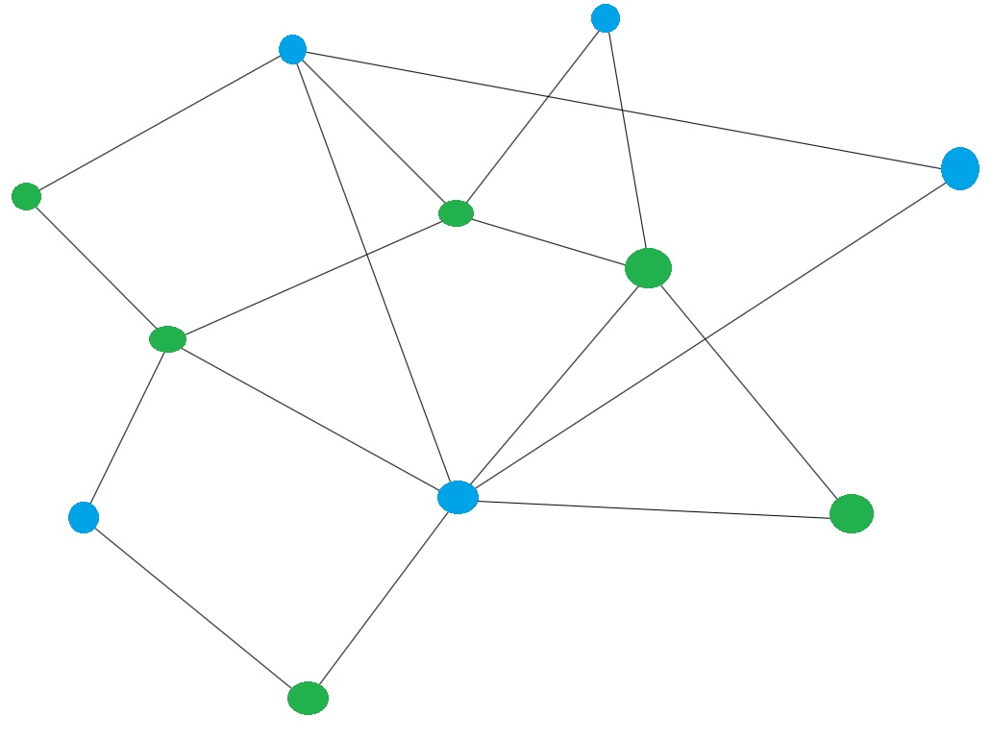
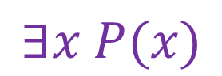
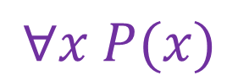
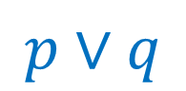
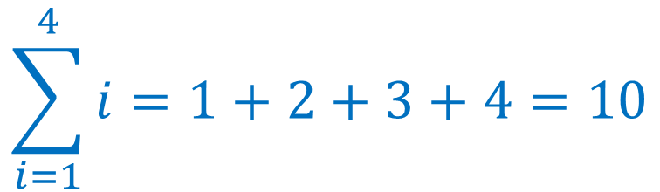
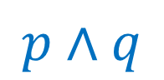
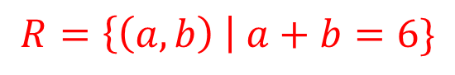

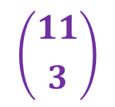
Topics
$$p∧q$$
$$p∨q$$
Propositions and Logic
Predicates and Quantifiers
Sets
Functions
Relations
Number Theory (Integers, prime numbers)
Combinatorics
Sequences and Summations
Probability
Graphs
Trees
$$∀x P(x)$$
$$∃x P(x)$$
$$F(x)=x^{2},x∈ℝ$$
$$R=\left\{\left(a,b\right) \right| a+b=6\}$$
2,3,5,7,11,13,17,19...
$$\sum_{i=1}^{4}{i}=1+2+3+4=10$$
$$\left({11 \atop 3}\right)$$

Slide 5
Google Colab Demo
Saving your work
Markdown / LaTeX
Python

Slide 6
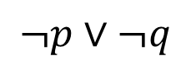
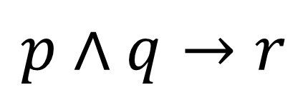
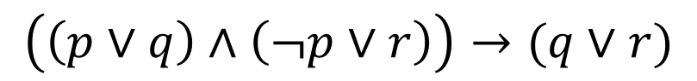
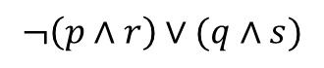
Propositions & Logic
$$p∧q→r$$
$$¬p∨¬q$$
$$¬\left(p∧r\right)∨(q∧s)$$
$$\left(\left(p∨q\right)∧\left(¬p∨r\right)\right)→(q∨r)$$

Slide 7
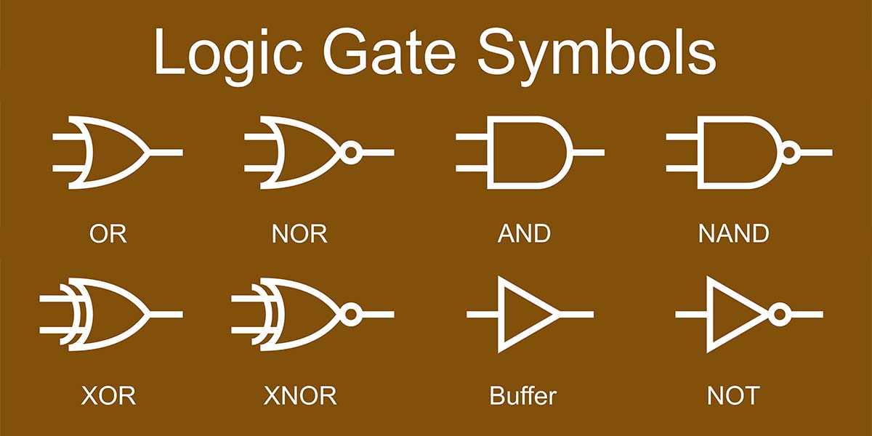
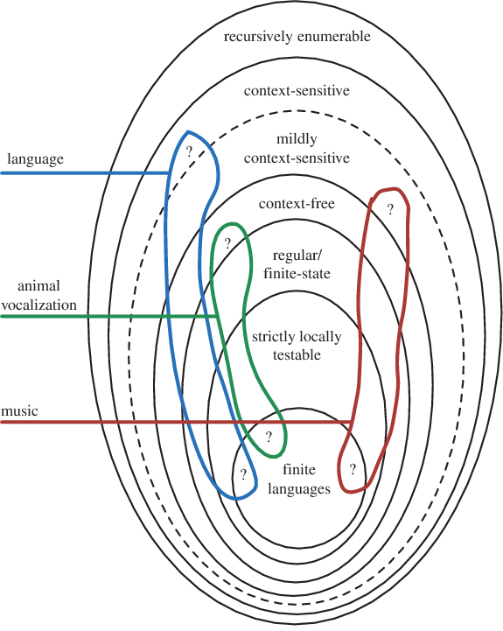
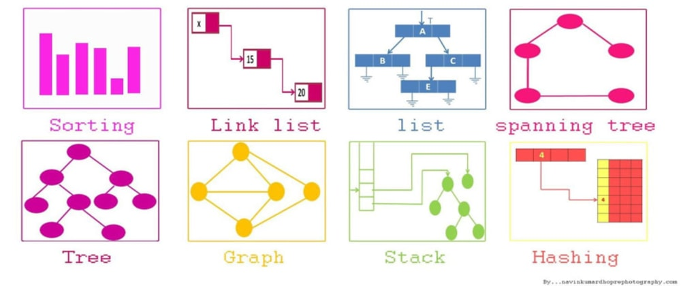
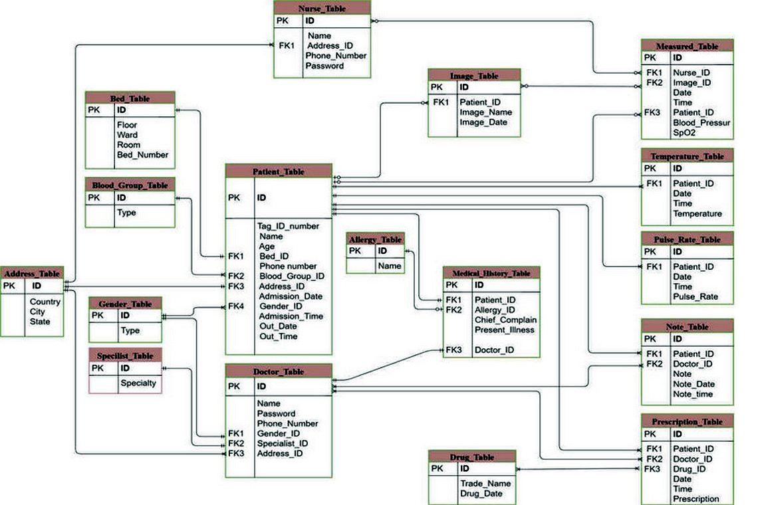
Why do I need this?
Rules of Logic are everywhere:
Mathematical reasoning
Computer circuits (Logic gates)
Formal Languages (computer languages)
Data Structures
Algorithm Design
Compiler Design
Relational Database Theory
Computability Theory
…
All built on a foundation of formal logic

Slide 8
Why do I need this?
Why is it important to think logically?
Logic sharpens your thinking, allowing it to “cut” more powerfully.
Why know logic (formal or informal)?
Logic gives you a means to mechanize reasoning.
Mechanizing reasoning means programming a computer to do it.

Slide 9
Propositions
A proposition is...
A declarative sentence.
In other words, a sentence that is either True or False
The sky is blue
Today is Tuesday
We are in a discrete math class
2 + 2 = 5

Slide 10
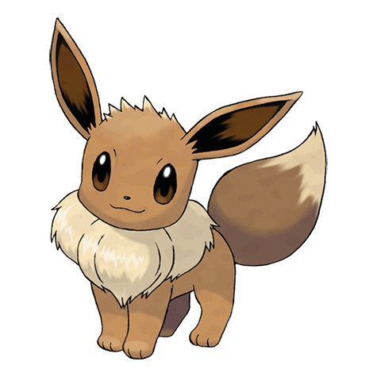
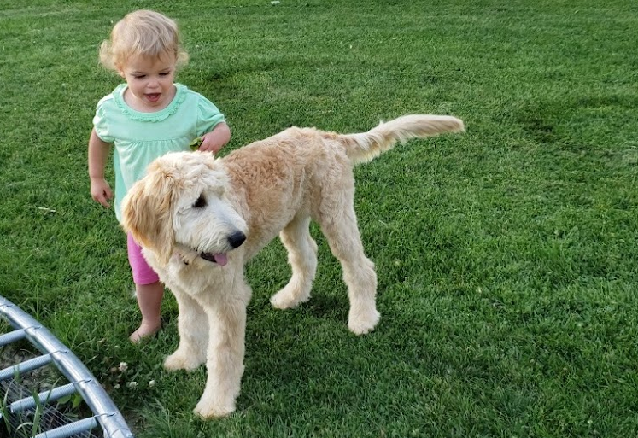
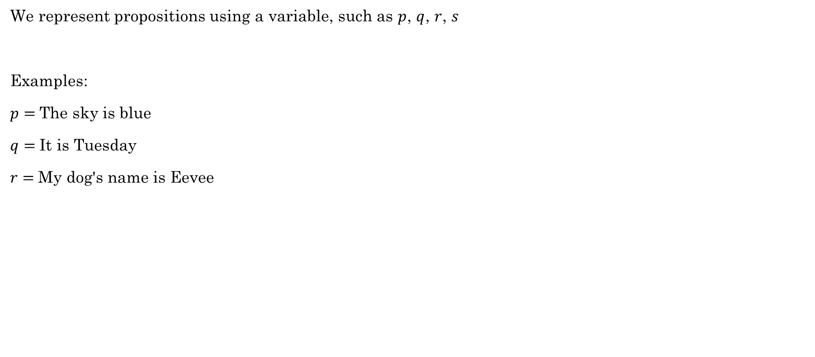
Propositions
We represent propositions using a variable, such as $p$, $q$, $r$, $s$
Examples:
$p=$The sky is blue
$q=$It is Tuesday
$r=$My dog's name is Eevee

Slide 11
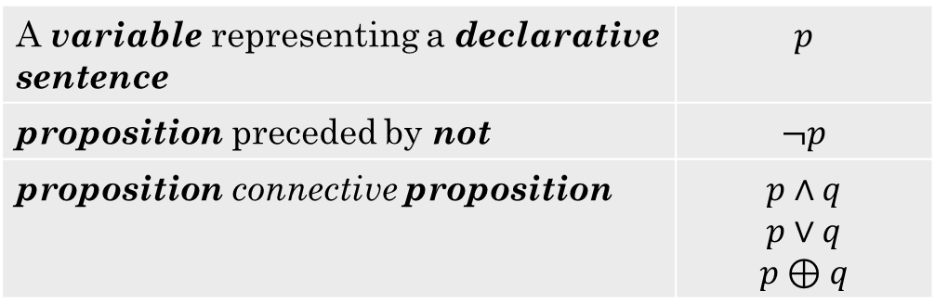
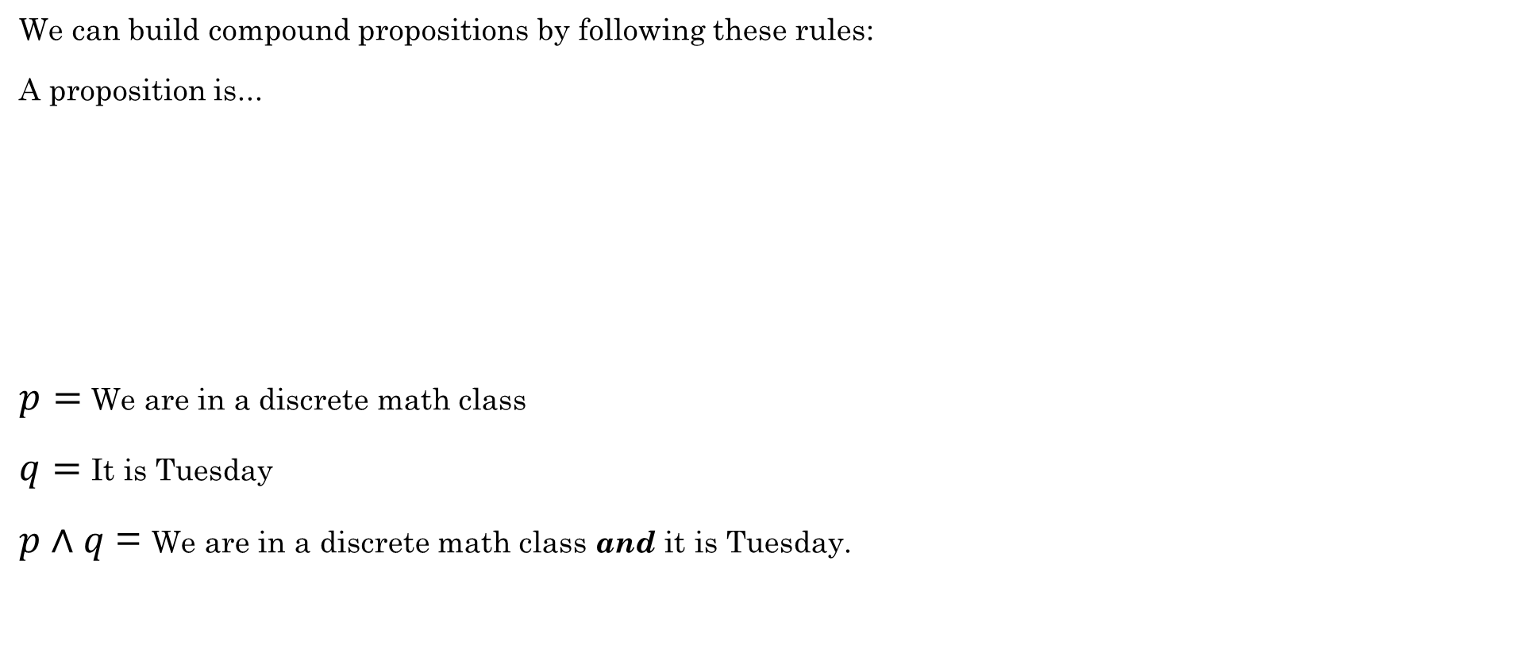
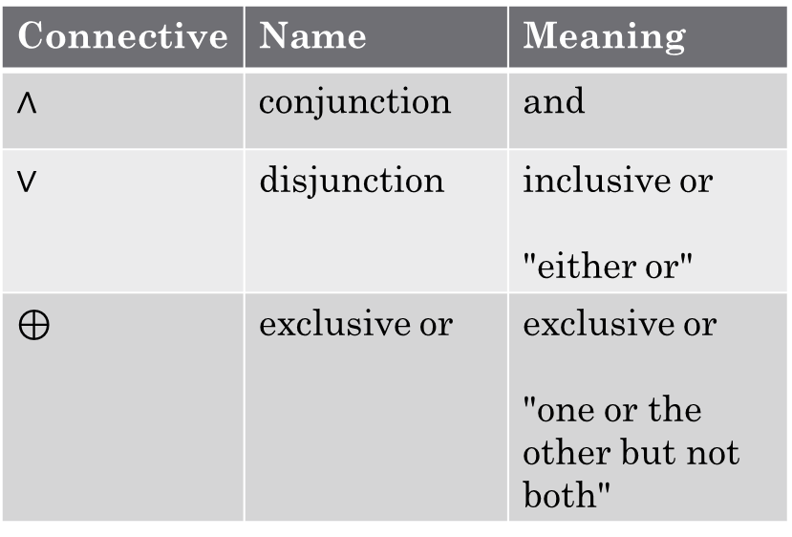
Propositions
We can build compound propositions by following these rules:
A proposition is...
$p=$We are in a discrete math class
$q=$It is Tuesday
$p∧q$ = We are in a discrete math class and it is Tuesday.
A variable representing a declarative sentence | $$p$$
proposition preceded by not | $$¬p$$
proposition connective proposition | $$p∧q$$ $$p∨q$$ $$p⊕q$$
Connective | Name | Meaning
$∧$ | conjunction | and
$∨$ | disjunction | inclusive or "either or"
$⊕$ | exclusive or | exclusive or "one or the other but not both"

Slide 12
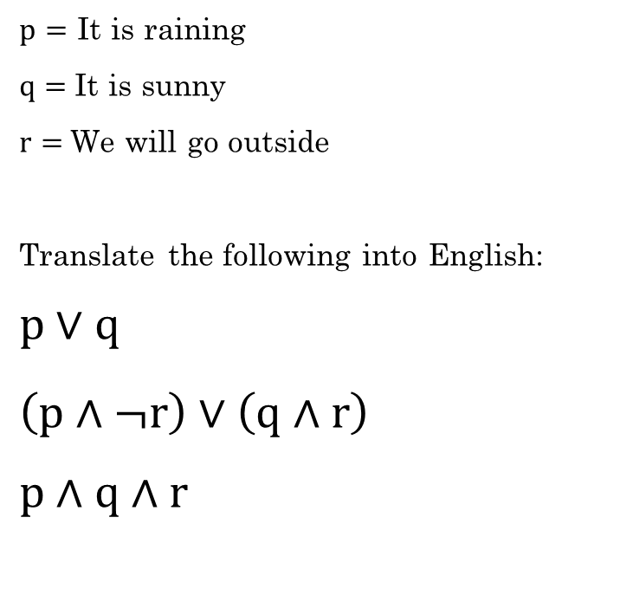
Translating to/from English
$p=$ It is raining
$q=$It is sunny
$r=$We will go outside
Translate the following into English:
$$p∨q$$
$$\left(p∧¬r\right)∨\left(q∧r\right)$$
$p∧q∧r$
It is raining or it is sunny.
It is raining and we will not go outside, or it is sunny and we will go outside.
It is raining and it is sunny and we will go outside.

Slide 13
Let's do Challenge 1.1.1 together.

Slide 14
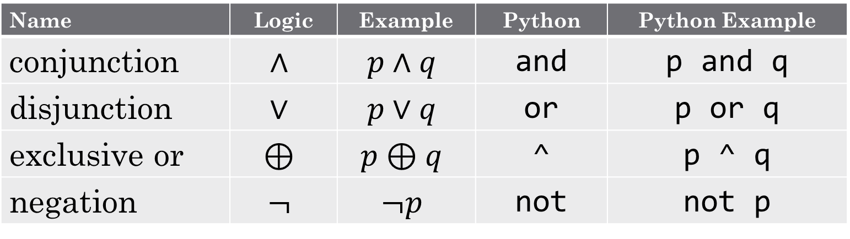
Logic symbols in Python
Name | Logic | Example | Python | Python Example
conjunction | $$∧$$ | $$p∧q$$ | and | p and q
disjunction | $$∨$$ | $$p∨q$$ | or | p or q
exclusive or | $$⊕$$ | $$p⊕q$$ | ^ | p ^ q
negation | $$¬$$ | $$¬p$$ | not | not p
Examples

Slide 15

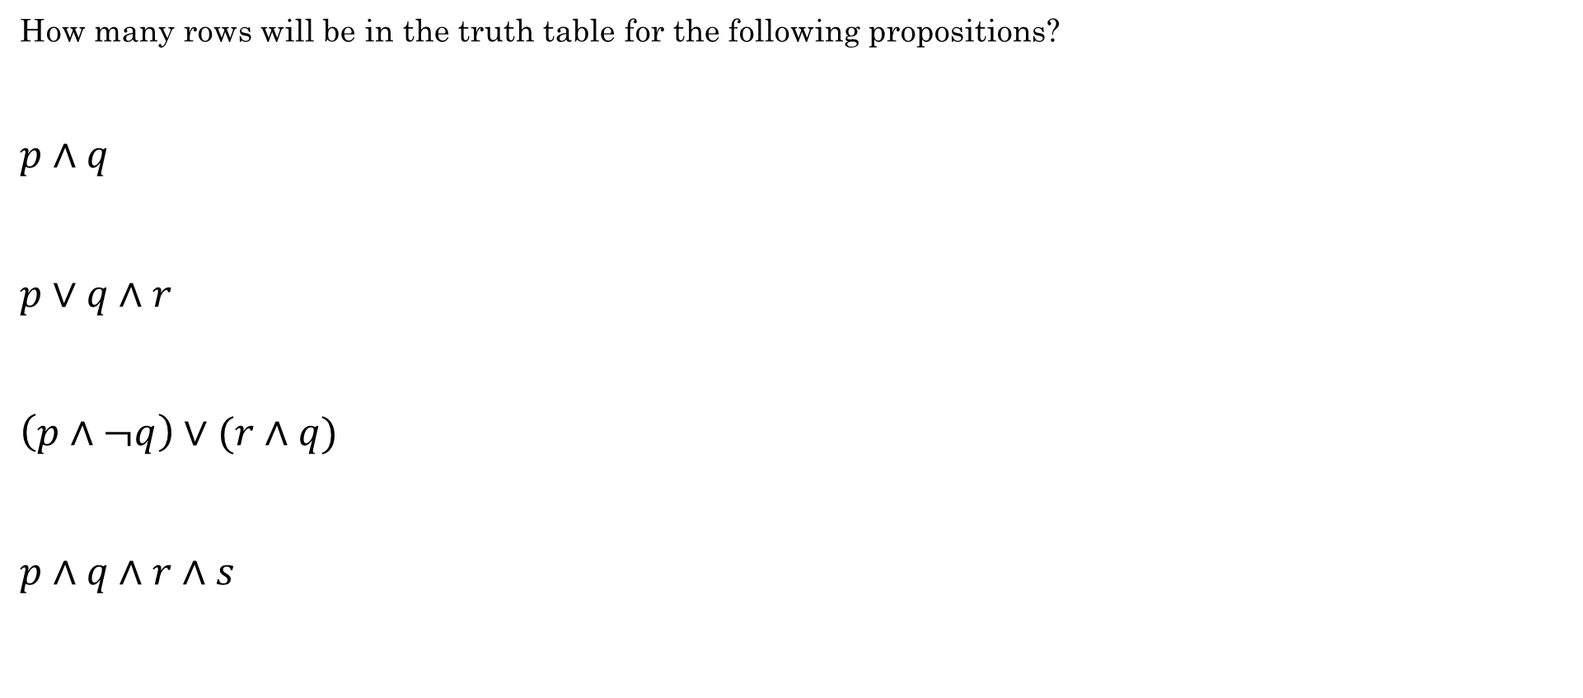
Truth Tables
How many rows will be in the truth table for the following propositions?
$p∧q$
$p∨q∧r$
$\left(p∧¬q\right)∨(r∧q)$
$p∧q∧r∧s$
4 rows
There are $2^{n}$ rows in a truth table with $n$ variables
8 rows
8 rows
16 rows!

Slide 16
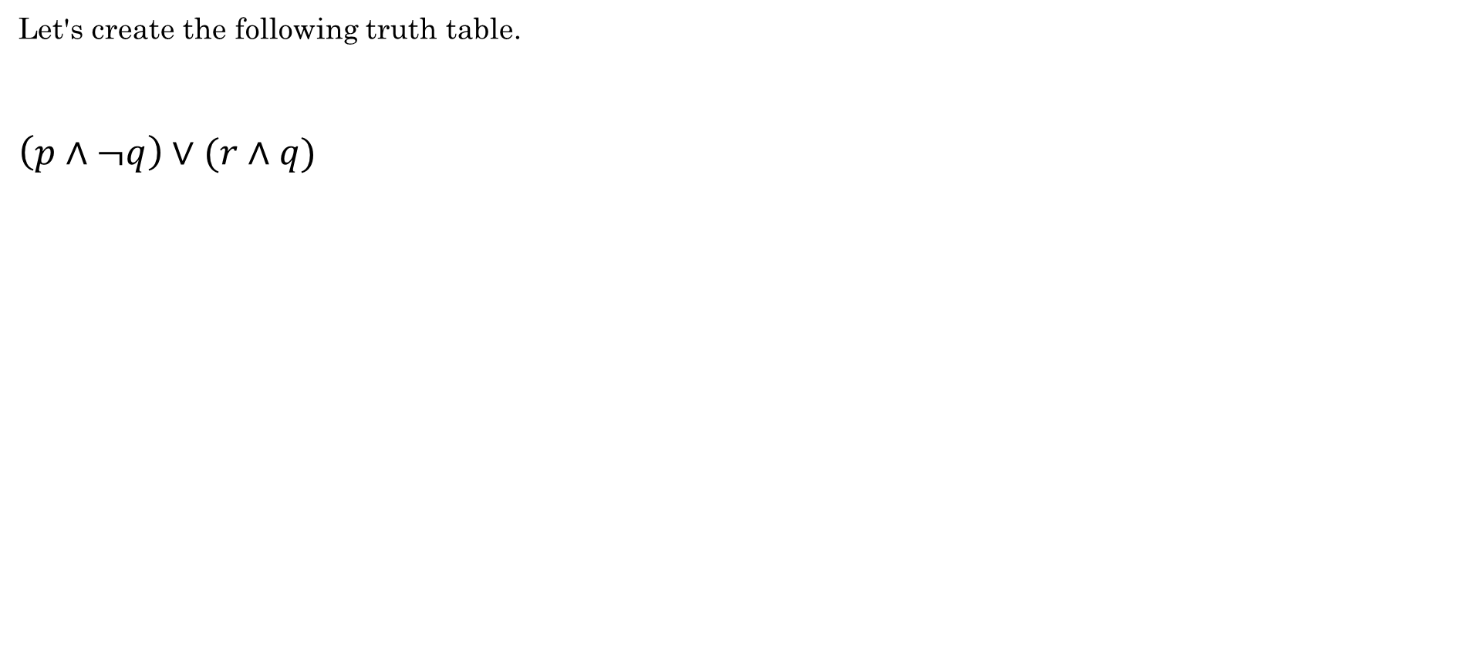
Truth Tables
Let's create the following truth table.
$\left(p∧¬q\right)∨(r∧q)$

Slide 17
Practical Uses of Logical Operators
Search Engines
Conditionals in programming
Can you think of any others?

Slide 18
Group Activity
With a group of 2-3 people, work through the following Additional exercises at the bottom of reading 1.2
1.2.1

Slide 19
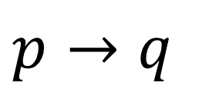
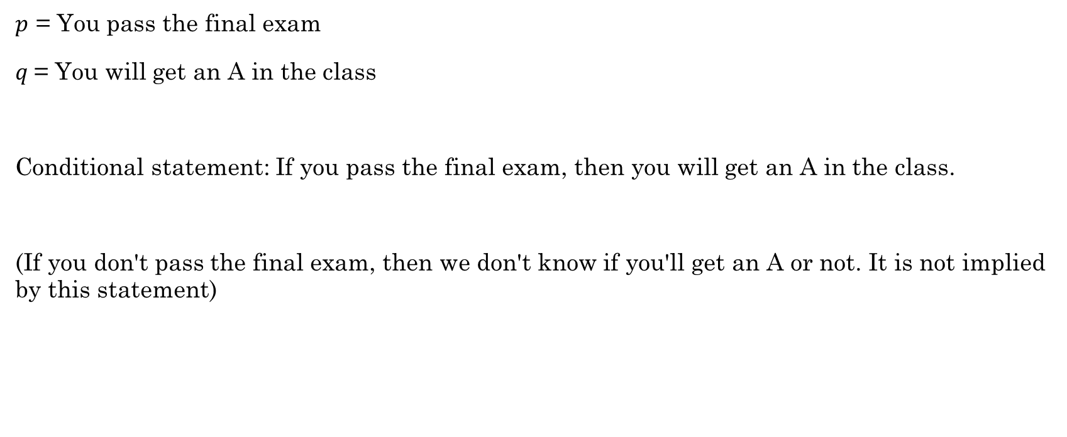
Conditionals or Implications
$p→q$
$p$ = You pass the final exam
$q$= You will get an A in the class
Conditional statement: If you pass the final exam, then you will get an A in the class.
(If you don't pass the final exam, then we don't know if you'll get an A or not. It is not implied by this statement)

Slide 20
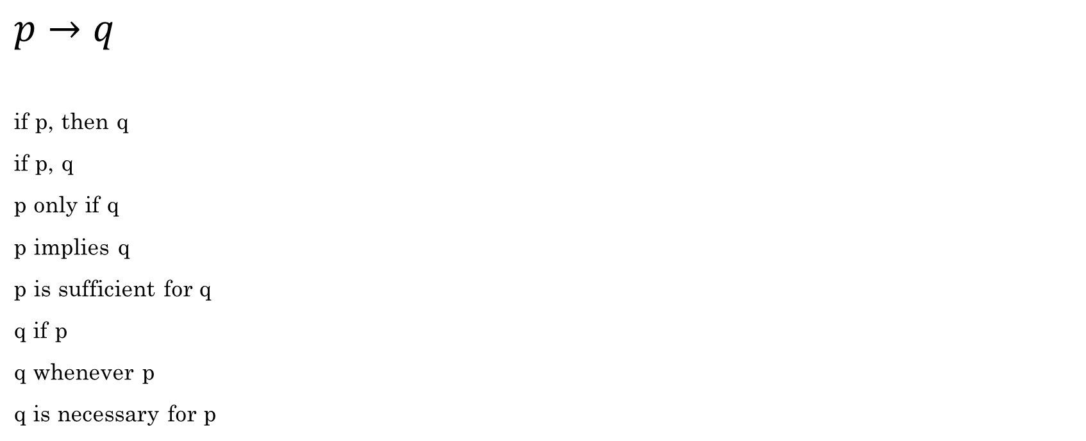
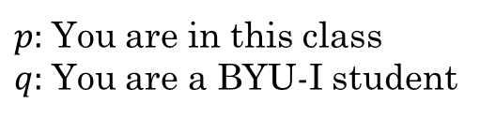
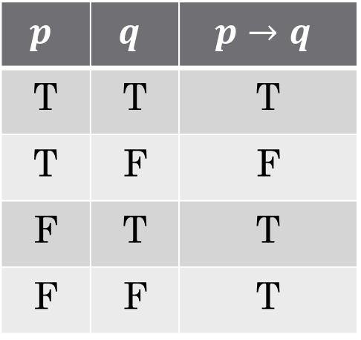
Conditionals or Implications
$$p$$ | $$q$$ | $$p→q$$
T | T | T
T | F | F
F | T | T
F | F | T
$p:$You are in this class
$q:$You are a BYU-I student
$$p→q$$
if p, then q
if p, q
p only if q
p implies q
p is sufficient for q
q if p
q whenever p
q is necessary for p
You being in this class is sufficient for me to conclude that you are a BYU-I student.
Python example

Slide 21
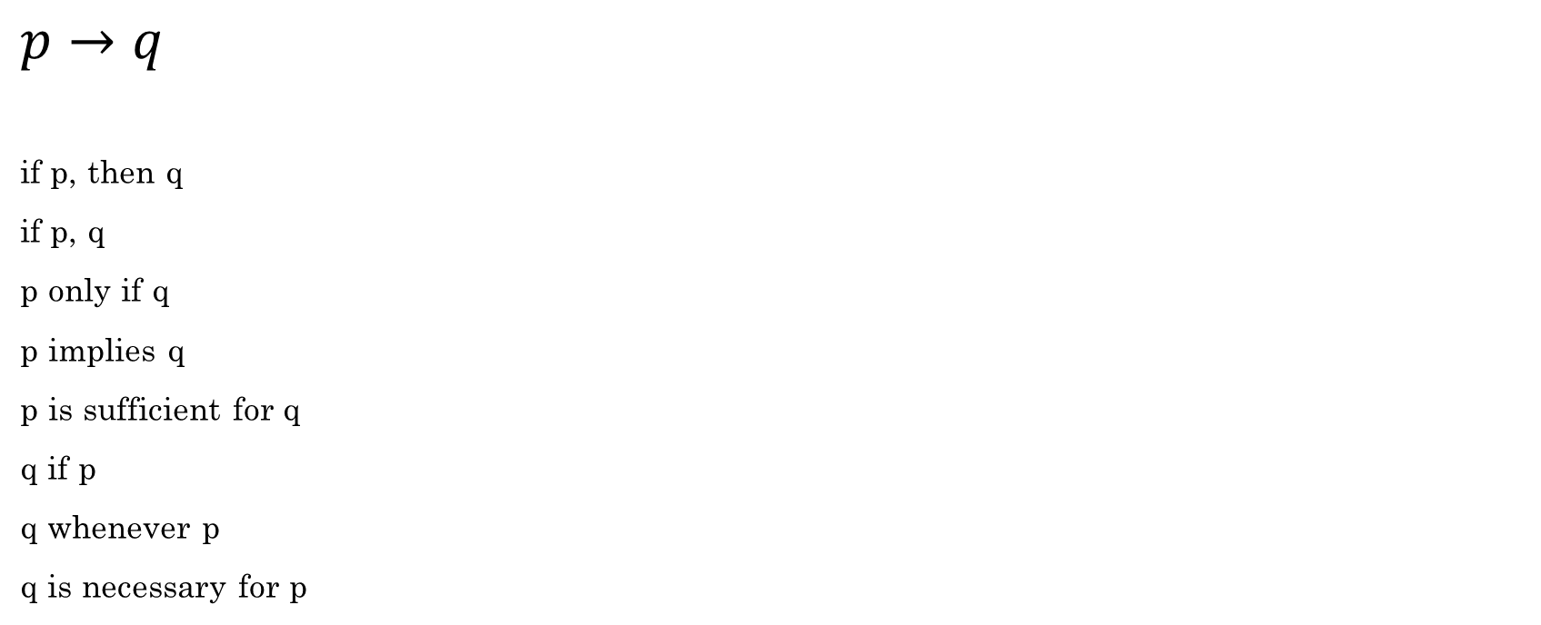

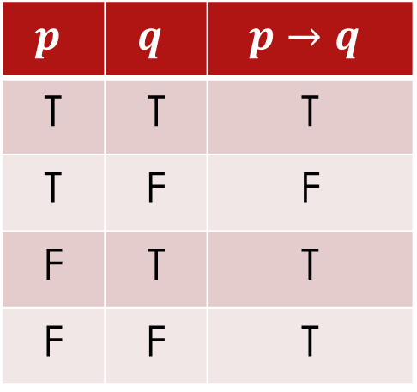
Conditionals: $p→q$
q
$$p→q$$
if p, then q
if p, q
p only if q
p implies q
p is sufficient for q
q if p
q whenever p
q is necessary for p
$$p$$ | $$q$$ | $$p→q$$
T | T | T
T | F | F
F | T | T
F | F | T
p

Slide 22
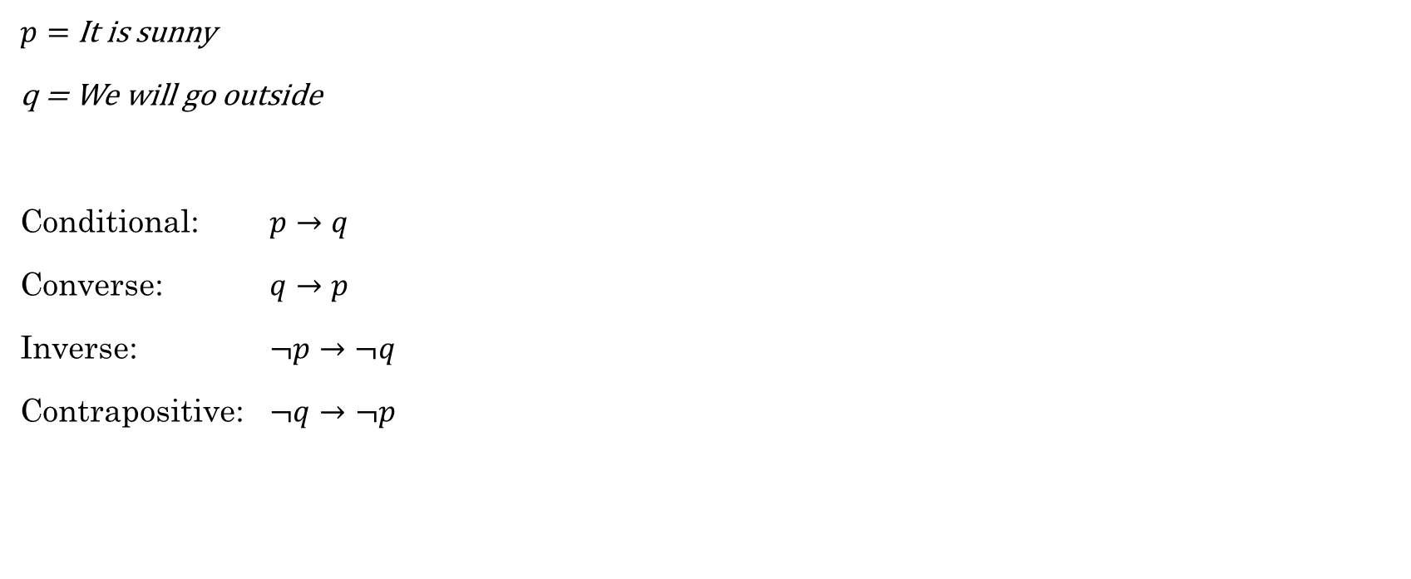
Conditionals: $p→q$
$p=$It is sunny
q = We will go outside
Conditional: $p→q$
Converse: $q→p$
Inverse: $¬p→¬q$
Contrapositive: $¬q→¬p$
If it is sunny, then we'll go outside.
If we go outside, then it is sunny.
If it is not sunny, then we will not go outside.
If we do not go outside, then it is not sunny.

Slide 23
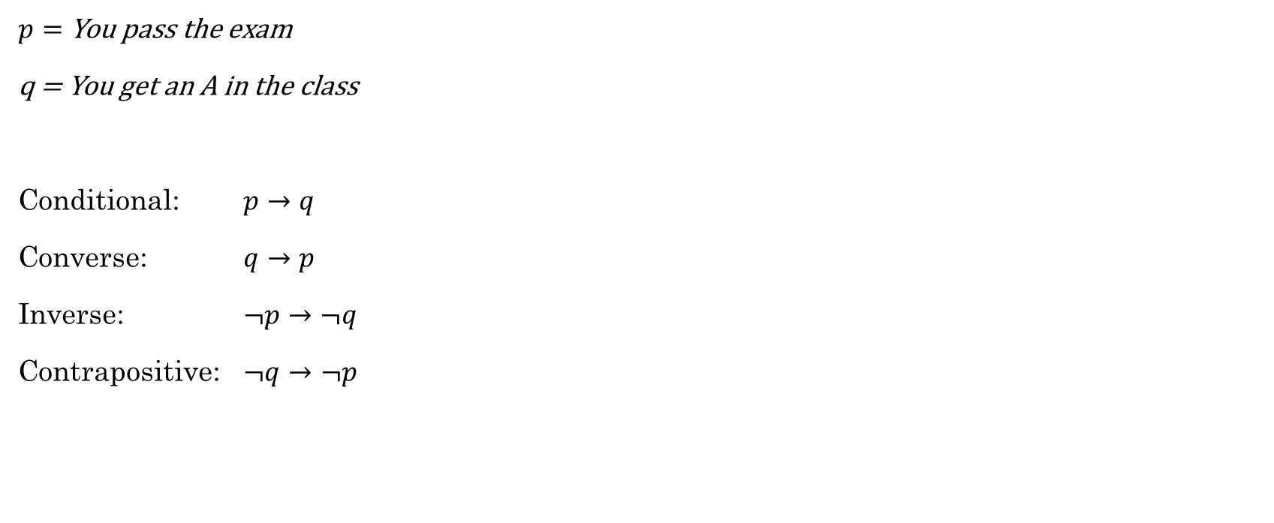
Conditionals: $p→q$
$p=$You pass the exam
q = You get an A in the class
Conditional: $p→q$
Converse: $q→p$
Inverse: $¬p→¬q$
Contrapositive: $¬q→¬p$
If you pass the exam, then you get an A in the class.
If you get an A in the class, then you passed the exam.
If you didn't pass the exam, then you won't get an A in the class.
If you don't get an A in the class, then you didn't pass the exam.

Slide 24
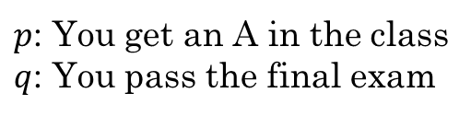
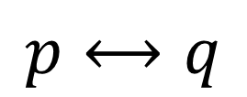
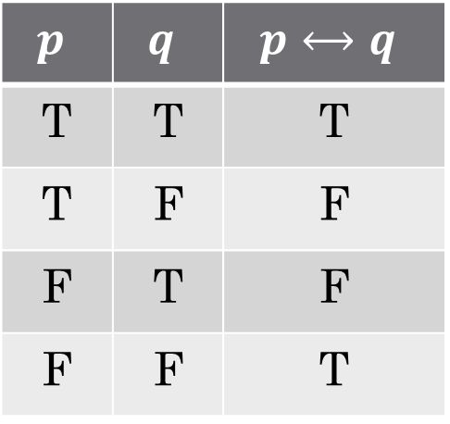
Biconditional
$$p$$ | $$q$$ | $$p⟷q$$
T | T | T
T | F | F
F | T | F
F | F | T
$$p⟷q$$
$p$: You get an A in the class
$q$: You pass the final exam
You will get an A in the class if and only if you pass the final exam.
p if and only if q
p iff q
p is necessary and sufficient for q
if p then q and if q then p
if p then q and conversely

Slide 25
Group Activity
With a group of 2-3 people, work through the following Additional exercises at the bottom of reading 1.3
1.3.1

